Slide 1
Chapter – 7
Users and Groups

Slide 2
Objectives:
At the end of this module, you would have gained fair knowledge on:
Concepts of User & Group account
User & Group Account Database
Administration of User & Accounts

Slide 3
The control of users and groups exists at the core of Red Hat Linux system administration. Users can be either people or logical users (accounts that exist for applications so that they can perform specific tasks). Both types of users have a Unique User ID and Group ID.
Groups are logical expressions of organization. Groups form the foundation of tying users together and giving them permissions to read, write, or execute a given file
Proper management of users and groups, as well as assigning and revoking permissions, is one of the most important tasks of a system administrator.

Slide 4
The User Database Files
In order to understand the concept of users, you need to know the format of the user database files, /etc/passwd and /etc/shadow. Each line in both files consists of colon-separated fields, one line per user. The format of the password file /etc/passwd is given below.
Username: password: uid: gid: comment: home directory: shell
Username: - Username is the unique name of the user.
Password: - This field contains the encrypted password of the user account. But if the shadowing is enabled this file contains only a X which indicates that the user’s password is stored in /etc/shadow file.
Uid: - The uid field contains the unique user identification number of the user.
Gid: - This field contains the user’s primary group identification number.
Comment:- This is an optional field which contains some comments about the user – normally his full name.

Slide 5
Directory:- This field contains the path to the user’s home directory.
Shell:- This field contains the default shell which has to be activated when the user is logged in.
Given below is a sample entry available in the /etc/passwd file
User1:g12fyhq:150:150:Accel it academy:/home/user1:/bin/bash
The above entry indicates that the user name is user1, password is g12fyhq, uid is 150, gid is 150, comment is Accel it academy, user’s home directory is at /home/user1 and the default shell of the user is /bin/bash.

Slide 6
The Shadow Password System
Shadow passwords offer a number of distinct advantages over the traditional password system, including:
Improved system security by moving the encrypted passwords normally found in /etc/passwd to /etc/shadow, which is readable only by root.
Information concerning password aging, how long it has been since a password was last changed.
Control over how long a password can remain unchanged before the user is required to change it

Slide 7
The /etc/shadow file contains the following fields:
1.The account name
2.The account’s encrypted password
3.The number of days elapsed since 1 January 1970 to the day last password was changed
4.The minimum number of days required between password changes
5.The maximum number of days after which password must be changed
6.The number of days before password expires the user is be warned
7.The number of days after the password expires before the account is disabled
8.The number of days since 1 January 1970 after which the account is disabled

Slide 8
Tools for User and Group Administration
Managing users and groups has traditionally been tedious, but Red Hat Linux provides a few tools and conventions to make users and groups easier to manage.
While you can use useradd to create a new user from the shell prompt, a popular way to manage users and groups is through
# redhat-config-users.

Slide 9
User and Group Configuration
useradd command
The useradd command can be used to create user accounts. The command format is given below:
useradd [-u UID][-g GID] [-G group1,group2…] [-c comment] [-s shell] [-d home] [-e expire_date] [-f n] –m <username>
-u UID User identification number. If not specified the next available user ID will be taken as the UID
-g GID To specify the primary group ID for the user
-G group1 To specify the supplementary groups where the user should have the membership
-c To specify the comment.
-s To specify the default shell of the user. If not specified /bin/bash (Bourne again shell) will be taken as the default shell.

Slide 10
-d To specify the path for the home directory. If not specified home directory will be created as /home/<username>
-e To specify the date of expiry of the user account in YYYY-MM-DD format.
-f n Disable the account n days after the account password expires.
-m To create the home directory if it does not exists.
<username> Name of the useraccount.
# useradd –u 210 –g 300 –s /bin/ksh -d /home/manoj -m manoj
The above command will create a user account named manoj with UID 210, GID 300, Korn Shell as the default shell and home directory as /home/manoj.
# useradd aita

Slide 11
The passwd command
After creating a user account you must set a password for that user account using the passwd command as follows:
# passwd aita
Enter the password:
Confirm the password:
Only root can able to specify a username along with the passwd command. The other users can use the passwd command without any argument to change their own passwd.

Slide 12
usermod command
The usermod command is used to modify the user parameters as follows
usermod [-u UID] [-g GID] [-G grop1,group2…] [-c comment] [-s shell]
[-d home] [-e expire_date] -l -L -U –m <username>.
The options are almost same as useradd command.
-l This option is used to change the user’s login name alone
-L This option is used to lock a user account.
-U Is used to unlock the useraccount.

Slide 13
The chage command
The chage command is used to set password aging policies.
# chage [options] username
The options are given below
-m Minimum days required between password changes.
-M Maximum number of days a user can use the same password without changing it.
-E <date> Password expiry date in YYYY-MM-DD format.
-W Set warning days as the number of days before password expiration during which the user is warned that his password is due to expire.

Slide 14
The userdel Command
The userdel command can be used to delete a user account.
userdel [-r] username
The –r option is used to remove the users home directory along with the user account.

Slide 15
Group Administration
A group contain similar type of users as it members. In traditional Unix environment security and permissions are assigned with the help of group accounts. Linux provides a set of commands for administering the group accounts
As like /etc/passwd file for user accounts, group account information will be stored in /etc/group file. In this file one line will be available for each group with colon-separated fields as follows
groupname:passwd:gid:userlist
Groupname is the name of the group
Password is an optional field containing the encrypted group password.
Gid is the numeric group ID number.
Uselist is a comma-separated list of the user account names that comprise the group.
A typical entry in the group file might resemble the following:
aita : x : 510 : manoj, babu, ram

Slide 16
The groupadd command
The groupadd command can be used to create new group accounts.
groupadd [ -g GID ] group name
-g is the option used to specify the group identification number. If it is not specified in the command line next available group ID will be taken as the new GID
# groupadd aita
The above command will create a group called aita

Slide 17
The groupmod command
The groupmod command is used to modify the group parameters, normally the gid or the group name as follows. groupmod [ -g new gid ] [ -n new name ] groupname
-g option is used to change the group ID and the –n option is used to change the group name alone.
The groupdel command
The groupdel command is used to delete the user accounts as follows groupdel groupname

Slide 18
Using Graphical tools
• On the GNOME desktop, go to the Main Menu Button (on the Panel) --> Programs --> System --> User Manager.
• On the KDE desktop, go to the Main Menu Button (on the Panel) --> Red Hat --> System --> User Manager.

Slide 19
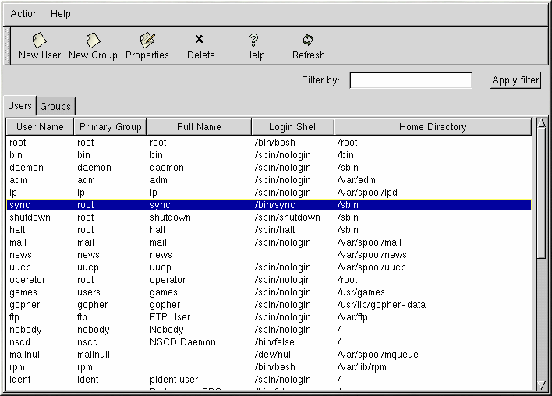

Slide 20
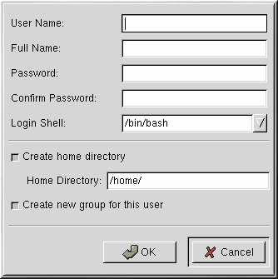
Adding a New User

Slide 21
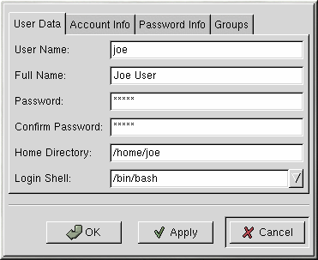
Modifying User Properties

Slide 22
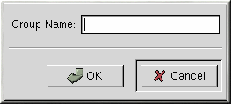
Adding a New Group

Slide 23
The su Command
The su – Switch user command is used to get the privilege of a different user with out logging to the system using that user name. The command format is as follows.
su [ - ] username
The - is used as a option to get the exact environments like the home directory, path etc of the changed user account. If you have not specified a user name su will try to acquire the root’s privilege.
$ su – manoj
password : ***********
$
Now you got the privilege of the user manoj.
$ exit
$
Now you have returned back to the privilege of the original user
# su – manoj
$
Since you are using su as root it will not ask for the password of the new user.

Slide 24
The groups Command
The groups command will display the names of the groups where a user is having membership.
# groups
root bin admin daemon sys ….. etc
# groups user1
The above command will display the names of the groups where the user user1 is having membership.

Slide 25
The id command
This command can be used to get the information about the uid, gid and supplementary group Ids and group names of a user account. If you invoke this command without any argument it will be given details about the current user.
# id
uid=0(root) gid=0(root) groups=0(root), 1(bin), 2(daemon), 3(sys), ………
# id user1
For getting the uid and gid information of a different user you can give the user name as an argument to id command as above.

